Slide 1
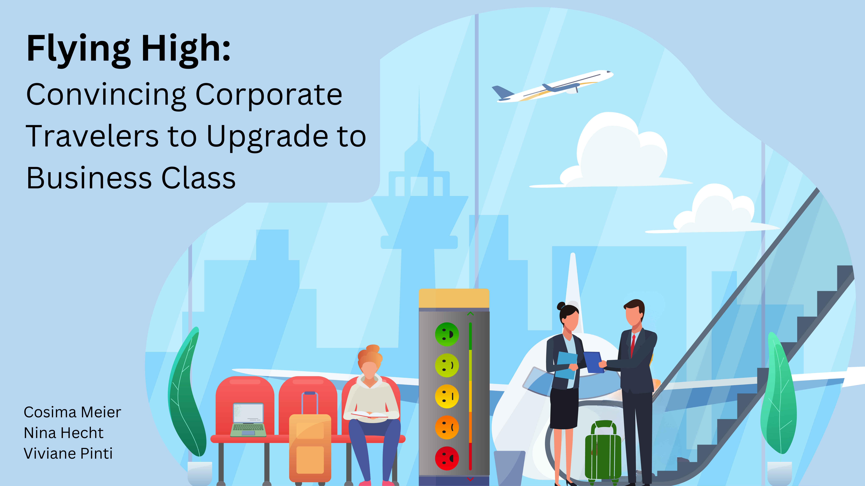
Notes:
Viviane:
Flying High: Convincing Corporate travelers to upgrade to business class
Boost passenger satisfaction and increase profits for your airline by prioritizing your business class passengers, particularly corporate travelers, who generate up to 70% of total profits.
However, not all corporate travelers choose to fly business class; some opt for economy. Evidence reveals that the needs of corporate travelers are not fully met in economy class. By encouraging them to upgrade, you can capture more profit and enhance their overall satisfaction.
With climate change impacting the number of flights and thereby increasing competition, passenger satisfaction becomes even more crucial.
To understand the needs of these valuable customers, we analysed the 'US Airline passenger satisfaction' dataset (which includes ratings of 14 air travel services and additional information about each passenger.)
Cosima:
Our aim is to identify which services should be marketed to corporate travelers flying economy class to convince them to upgrade to business class. By doing so, we can enhance passenger satisfaction and drive profits for your airline.
To determine which airline services to market, we compared passenger satisfaction of the airline services between economy and business class. We evaluated 14 different services and calculated the percentage of passengers who were satisfied or very satisfied (rated 4 or 5 on a scale) in this two classes. Then, we compared the proportions between economy and business class for each service to identify the largest differences.

Slide 2
